Slide 1

AKA Shield 101
Know Your Shield
Soror Shryl Avril, Chapter Protocol Chairman

Slide 2

WRONG = Illegal

Slide 3

RIGHT = Correct

Slide 4
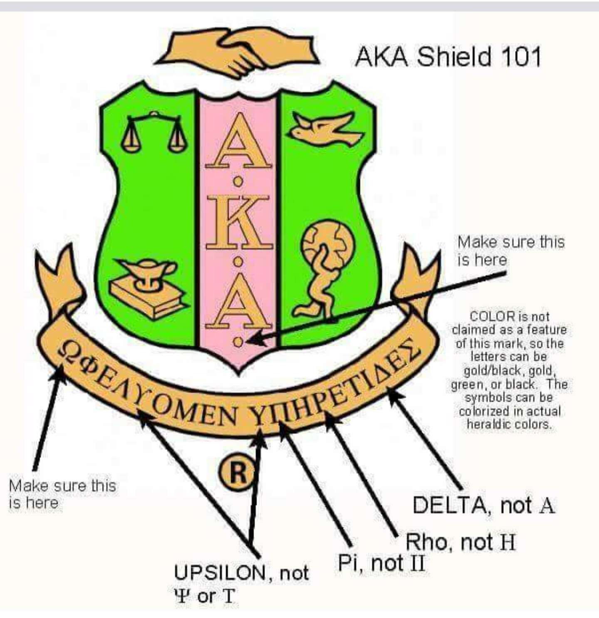

Slide 5






All Correct

Slide 6
Thank you!

